Slide 2
Exam – Part 1 17-05-2022

Slide 3
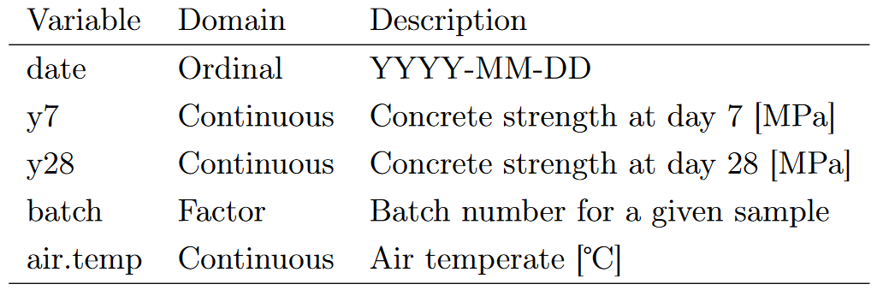
Available Data

Slide 4
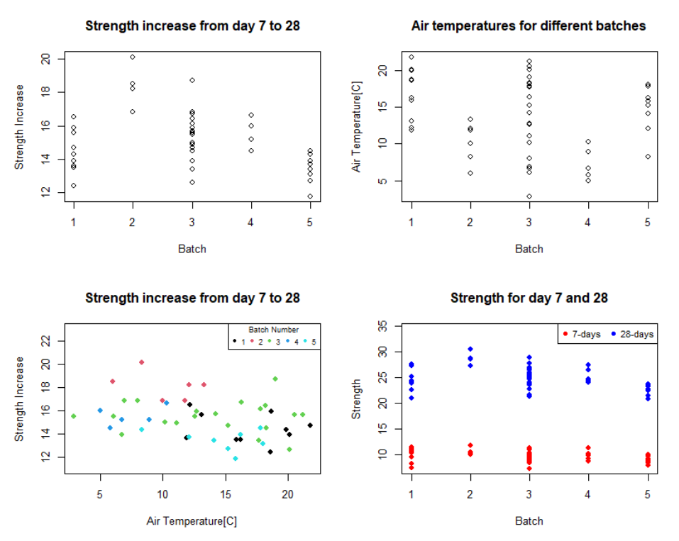
Concrete Strength

Slide 5
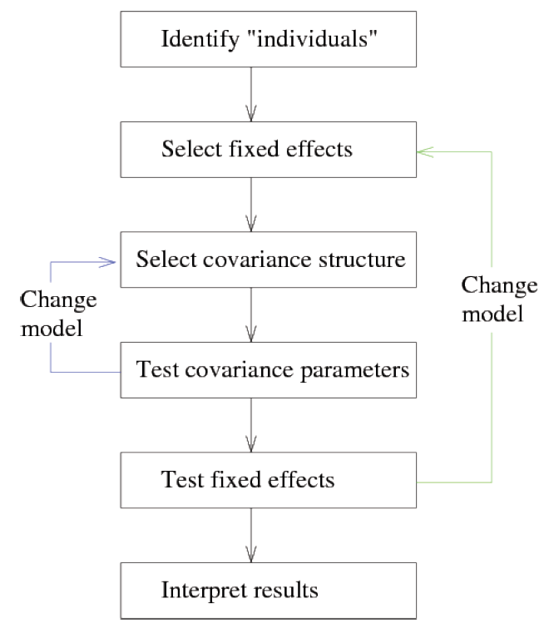
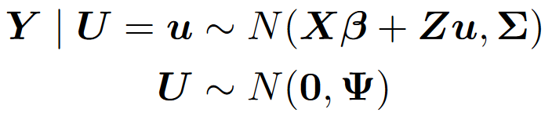
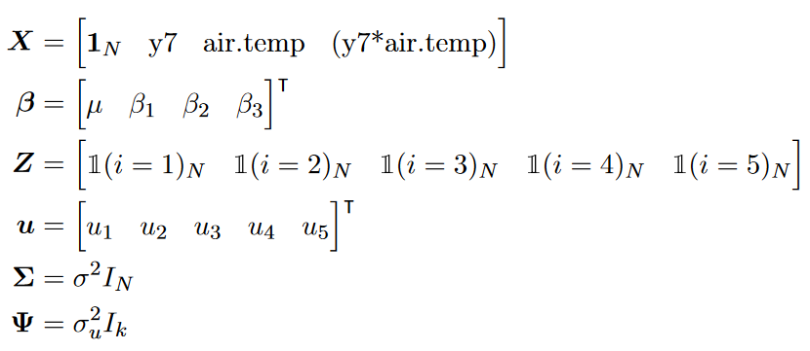
Model Building Framework

Slide 6
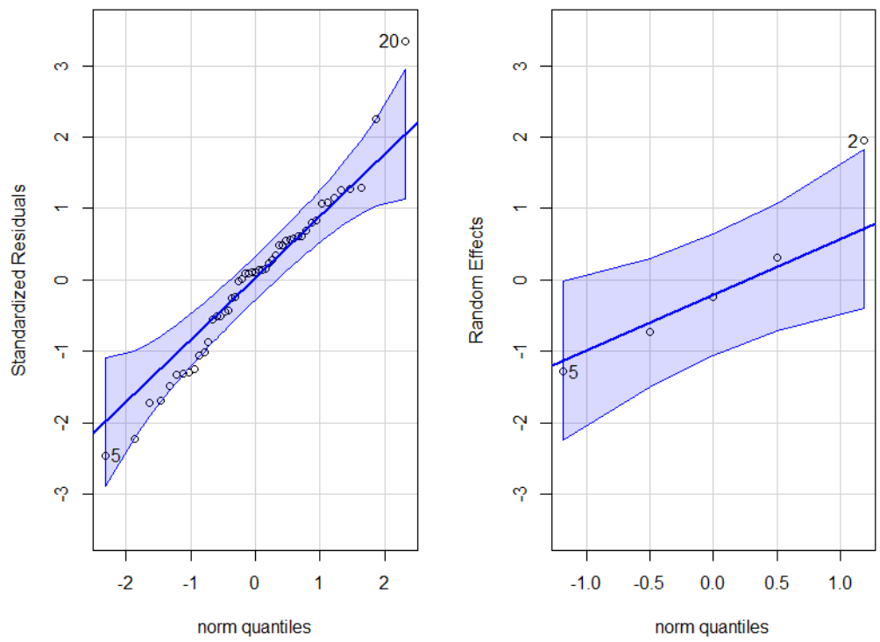
Diagnostics for Sufficient Model

Slide 7
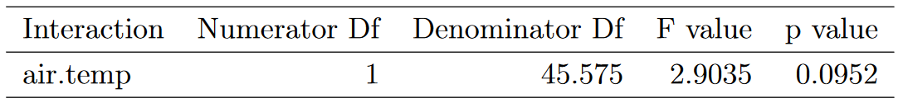
Model Reduction

Slide 8
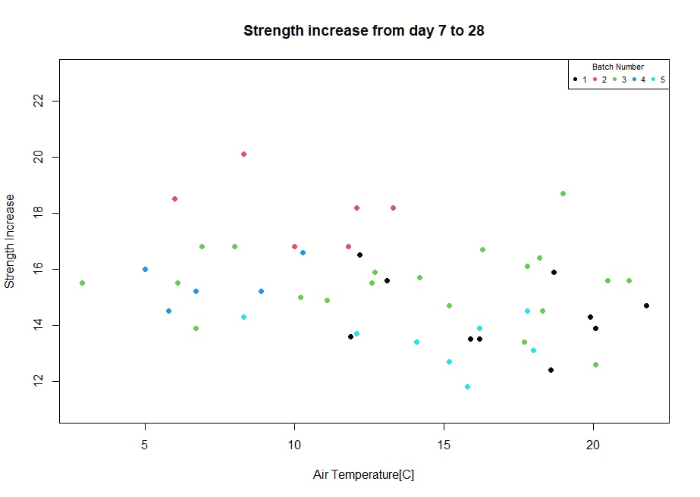
Conclusion

Slide 9

Simultaneous Modelling

Slide 10
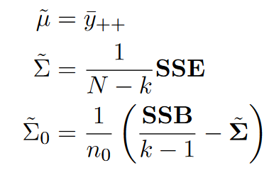
Parameter Estimates
2021-08-26
Parameters to estimate

Slide 11
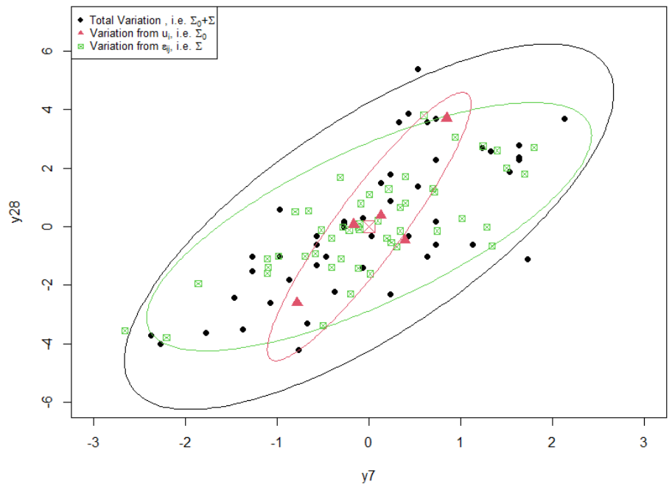
Visual Representation of Variance

Slide 12
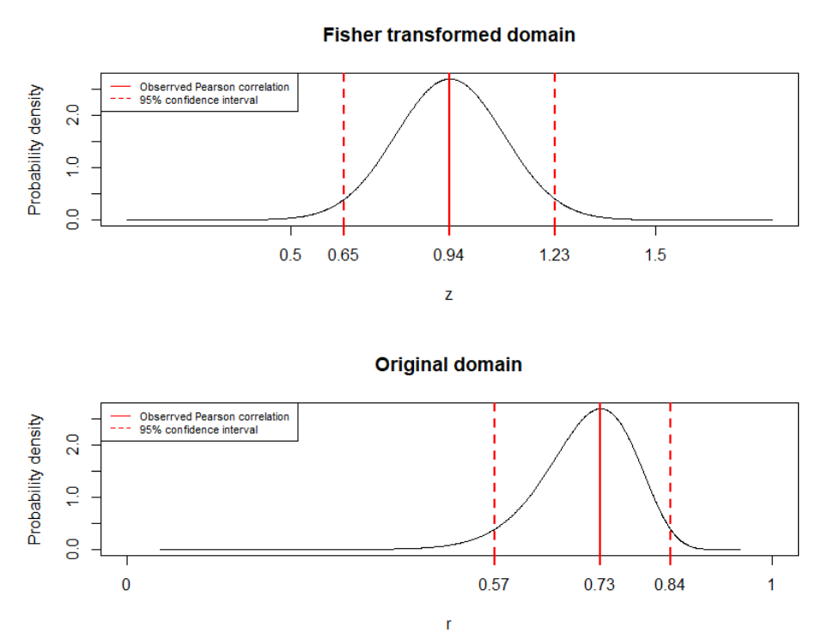
Correlation

Slide 14
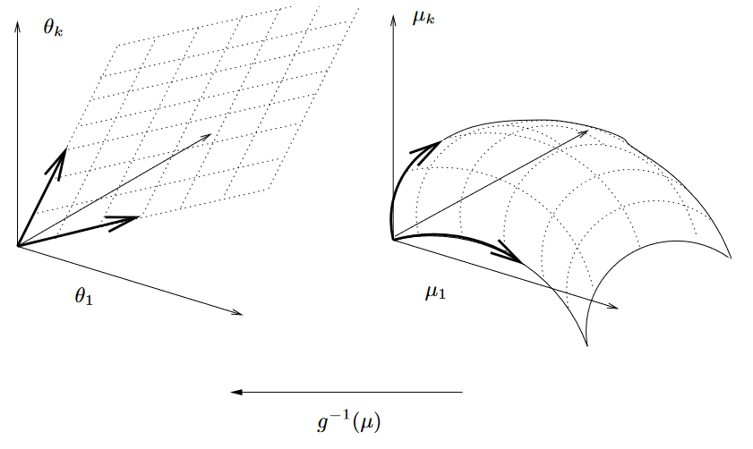
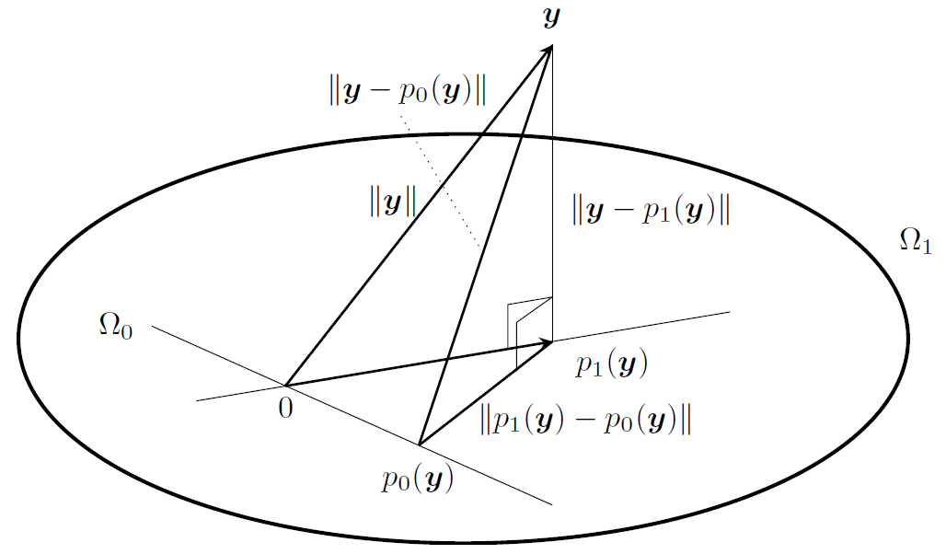
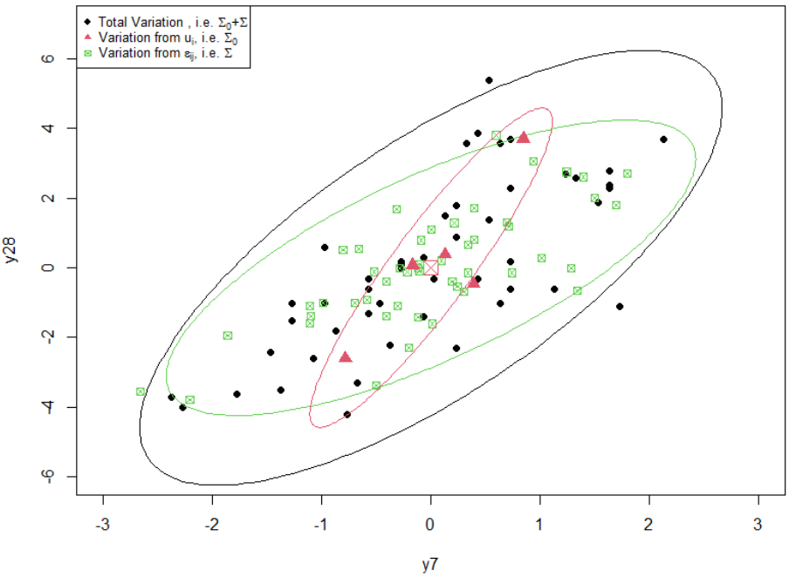
The great picture
2021-08-26
2021-08-26
Generalized Linear Models
General Linear Model
Generalized Linear Models
Mixed effect models

Slide 15
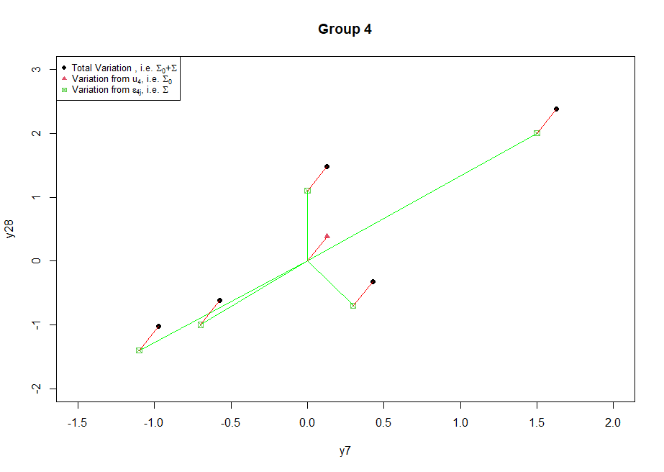
Linearity of residuals

Slide 16
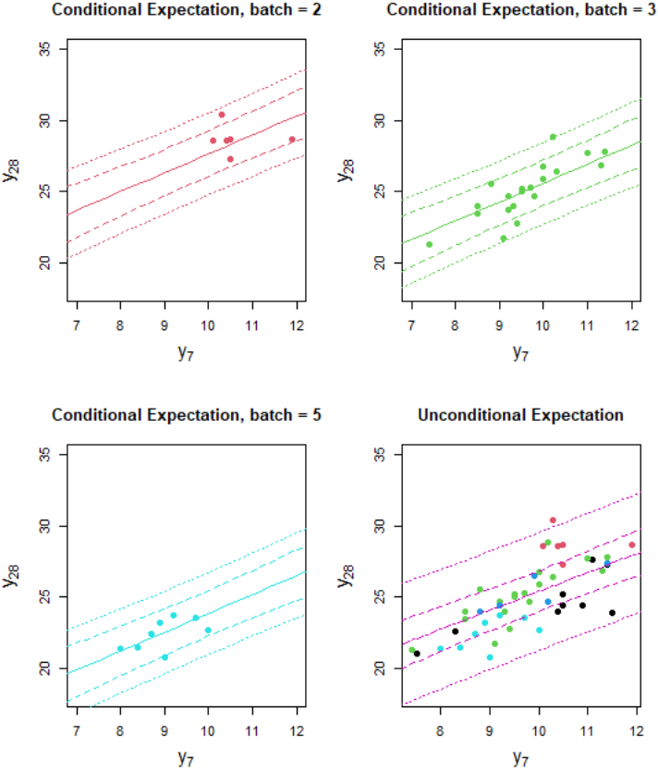
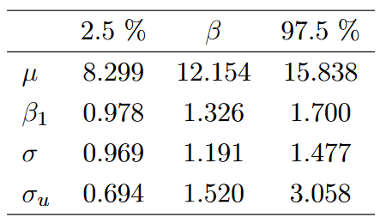
Final Model and Parameters

Slide 17
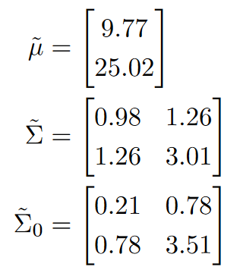

Parameter Estimates
2021-08-26
2021-08-26
Parameters to estimate
Estimated parameters
2021-08-26
New interpretation

Slide 18
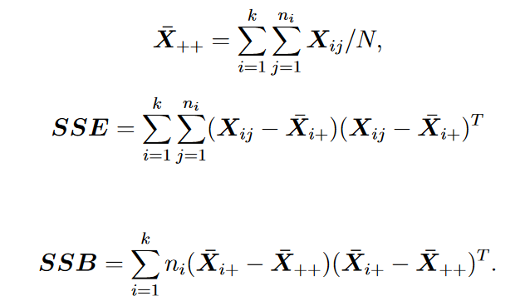
Explicit SSE and SSB

Slide 19
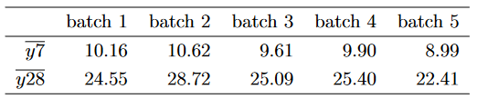
Means

Slide 20
Normal distribution
2021-08-26
New interpretation

Slide 21
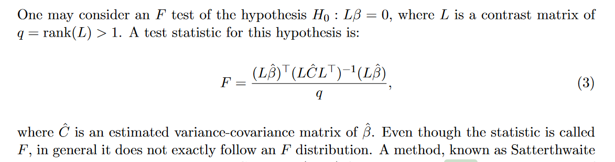
F distribution

